Slide 1
Asynchronous Methods for Deep Reinforcement Learning
Volodymyr Mnih, Adria Puigdomenech Badia, Mehdi Mirza, Alex Graves, Time Harley, Timothy P. Lillicrap, David Silver, Koray Kavukcuoglu
Google DeepMind
ICML 2016
Presented by Yoonsung Kim

Slide 2
introduction
Lightweight framework for deep reinforcement learning (no need for experience replay memory)
SOTA on Atari with half training time
Enables on-policy algorithms(Sarsa, actor-critic) as well as off-policy algorithms(Q-learning)

Slide 3



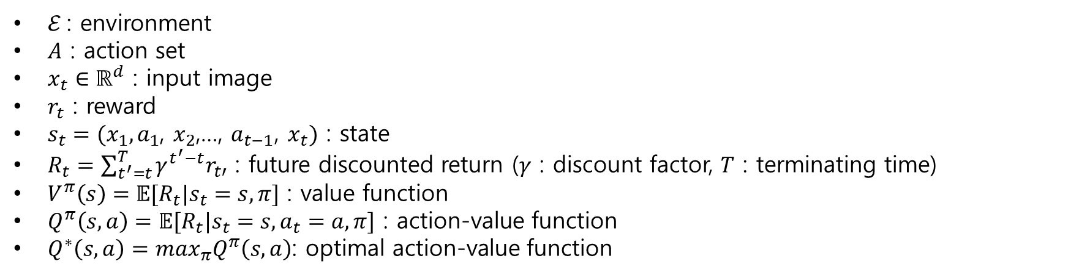



Definitions
input
$$x_{t}$$
$$r_{t}$$
$$r_{t+1}$$
$$a_{t}$$
$$x_{t+1}$$
$ℰ$ : environment
$A$ : action set
$x_{t}∈ℝ^{d}$ : input image
$r_{t}$ : reward
$s_{t}=(x_{1},a_{1}$, $x_{2}$,…, $a_{t−1}$, $x_{t})$ : state
$R_{t}=\sum_{t^{′}=t}^{T}{γ^{t^{′}−t}r_{t′}}$ : future discounted return ($γ$ : discount factor, $T$ : terminating time)
$V^{π}\left(s\right)=𝔼[R_{t}|s_{t}=s, π]$ : value function
$Q^{π}\left(s,a\right)=𝔼[R_{t}|s_{t}=s, a_{t}=a, π]$ : action-value function
$Q^{∗}\left(s,a\right)=\max_{π}Q^{π}\left(s,a\right)$: optimal action-value function

Slide 4

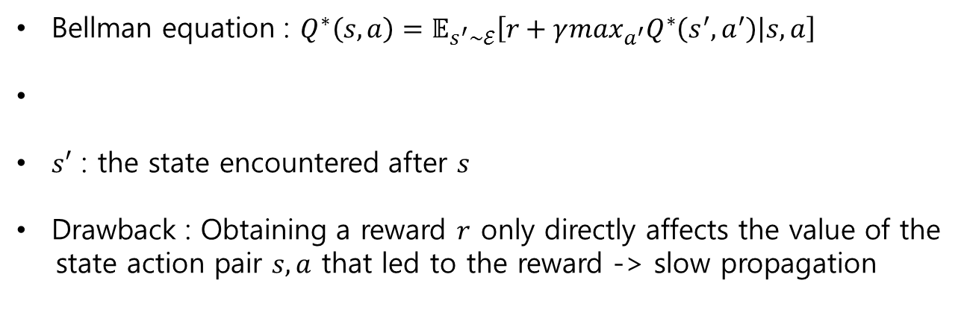
Baseline Methods
One-step Q-Learning
Bellman equation : $Q^{∗}\left(s,a\right)=𝔼_{s^{′}\sim ℰ}\left[r+γ\max_{a^{′}}Q^{∗}\left(s^{′},a^{′}\right) | s, a\right]$
$s′$ : the state encountered after $s$
Drawback : Obtaining a reward $r$ only directly affects the value of the
state action pair $s, a$ that led to the reward -> slow propagation

Slide 5
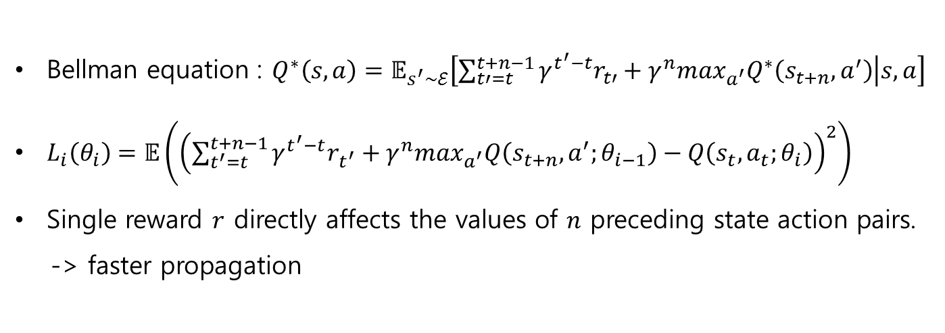
Baseline Methods
N-step Q-Learning
Bellman equation : $Q^{∗}\left(s,a\right)=𝔼_{s^{′}\sim ℰ}\left[\sum_{t′=t}^{t+n−1}{γ^{t^{′}−t}r_{t′}}+γ^{n}\max_{a^{′}}Q^{∗}\left(s_{t+n},a^{′}\right) | s, a\right]$
$L_{i}\left(θ_{i}\right)=𝔼\left({\left(\sum_{t^{′}=t}^{t+n−1}{γ^{t^{′}−t}r_{t^{′}}}+γ^{n}\max_{a^{′}}Q\left(s_{t+n},a^{′};θ_{i−1}\right)−Q\left(s_{t},a_{t};θ_{i}\right)\right)}^{2}\right)$
Single reward $r$ directly affects the values of $n$ preceding state action pairs.
-> faster propagation

Slide 6
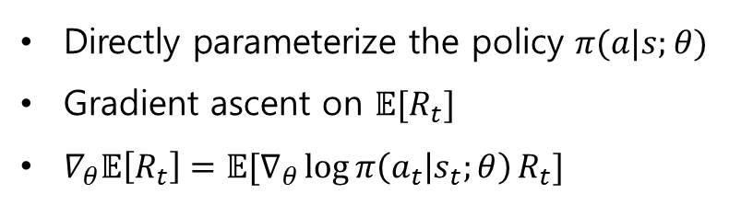
Baseline Methods
Policy gradient
Directly parameterize the policy $π(a|s;θ)$
Gradient ascent on $𝔼[R_{t}]$
$∇_{θ}𝔼\left[R_{t}\right]=𝔼[∇_{θ}\log{π\left(a_{t} | s_{t};θ\right)}R_{t}]$

Slide 7
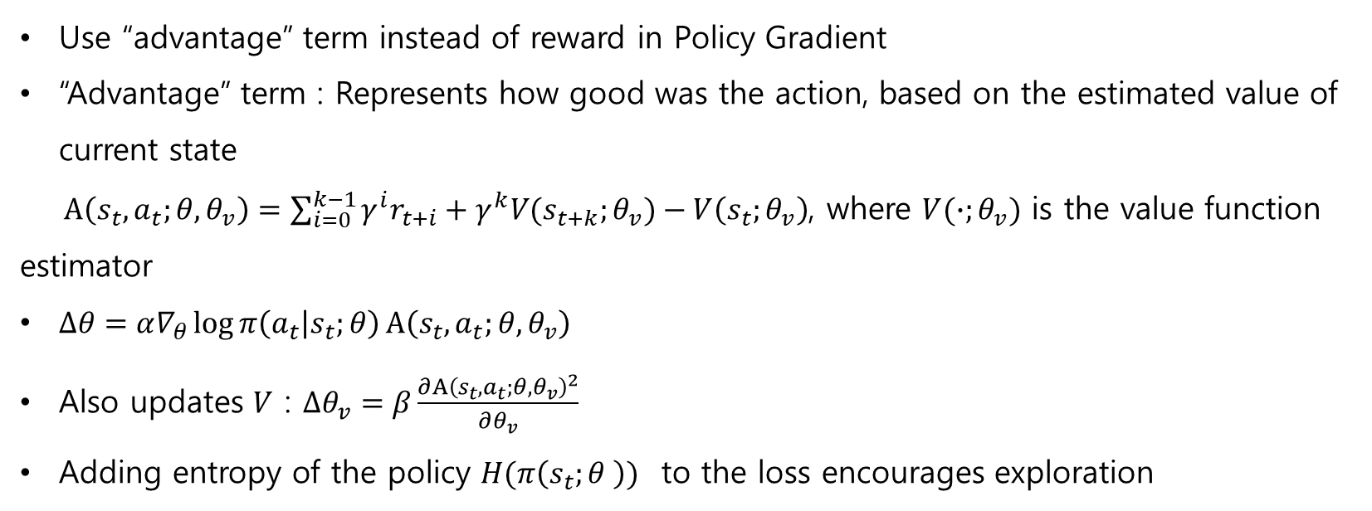
Baseline Methods
Advantage actor-critic
Use “advantage” term instead of reward in Policy Gradient
“Advantage” term : Represents how good was the action, based on the estimated value of current state
$A\left(s_{t},a_{t};θ,θ_{v}\right)=\sum_{i=0}^{k−1}{γ^{i}r_{t+i}}+γ^{k}V(s_{t+k};θ_{v})−V\left(s_{t};θ_{v}\right)$, where $V(∙;θ_{v})$ is the value function estimator
$∆θ=α∇_{θ}\log{π\left(a_{t} | s_{t};θ\right)}A\left(s_{t},a_{t};θ,θ_{v}\right)$
Also updates $V$ : $∆θ_{v}=β\frac{∂{A\left(s_{t},a_{t};θ,θ_{v}\right)}^{2}}{∂θ_{v}}$
Adding entropy of the policy $H(π\left(s_{t};θ \right))$ to the loss encourages exploration

Slide 8
Asynchronous RL Framework
Asynchronous actor-learners
Multiple CPU threads on a single machine
Multiple actors-learners running in parallel collect less correlated data
-> no need for experience replay
-> On-policy methods(Sarsa, actor-critic) are possible

Slide 9
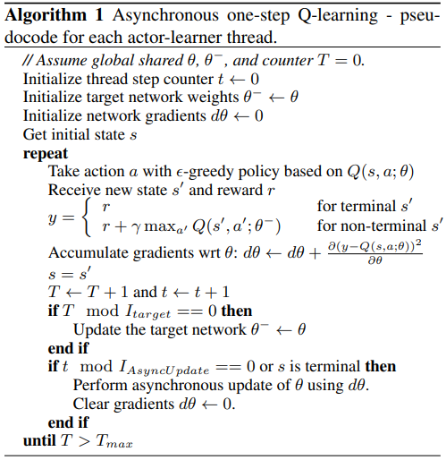
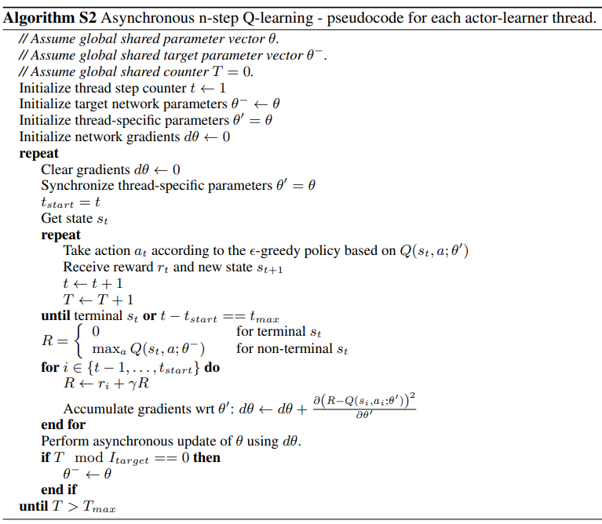
Asynchronous RL Framework
Shared models
Shared models
Each agent model
Synchronize
Target update
(Q-learning)
Update shared model
Update
shared model
Target update
(Q-learning)

Slide 10
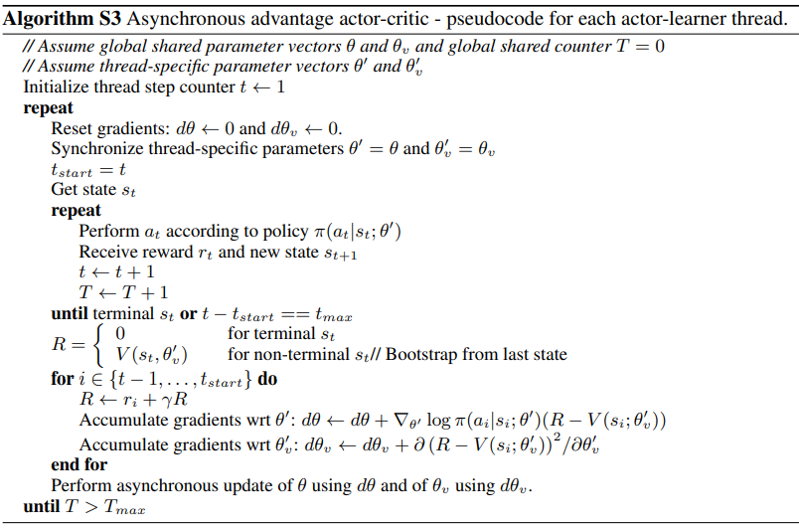
Asynchronous RL Framework
Shared model,
Each agent model
Synchronize
Update
shared model

Slide 11
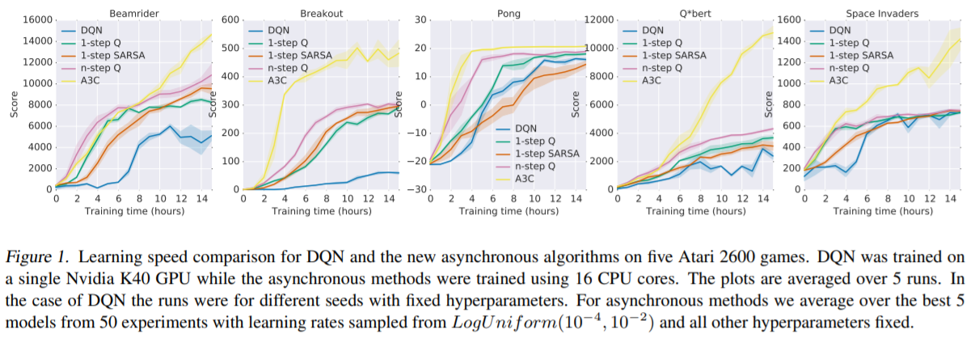
Results

Slide 12
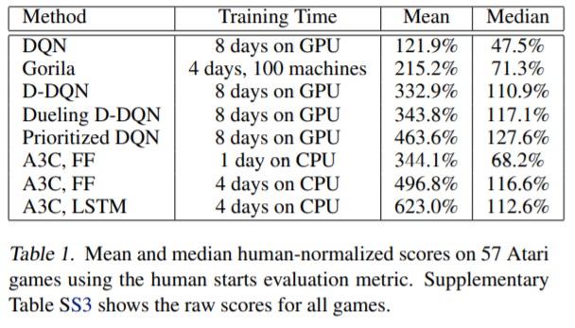
Results

Slide 13
Conclusion
Stable training is possible with both value-based and policy-based methods, off-policy as well as on-policy methods, and in discrete as well as continuous domains.
Using parallel actor-learners to update a shared model had a stabilizing effect.
Surpassed the SOTA in half the training time.

